Slide 1
CHECK DIABETES OF PATIENT USING MACHINE LEARNING ALGORITHM
SUBMITTED TO:
MR KAILASH JOSHI
NIELIT Haridwar
CREATED BY:
ROHAN SEKHRI
MLP Batch 26

Slide 2
Contents
Objective of the research
Problem Definition
Scope of work
Methodology
Result Analysis
Conclusion

Slide 3
Objective of the project
Possibility of weather a person is diabetic or not. diabetes depend on many small factors, using different factors, e.g. systolic blood pressure, pulse, age, etc., will help predict the diabetes conditions more accurately.
Using a rich and large numerical dataset of a hospital. Predicting the diabetes will produce better outcomes .
Using different machine learning algorithms, e.g. Linear Regression , Logistic Regression etc. and comparing the results to develop the best possible algorithm to predict the diabetes of a person.

Slide 4
Objective of the project
Comparing the results of these machine learning algorithms to develop the best possible algorithm to predict the diabetes.
There have been previous researches done on diabetes prediction. But most of their accuracy is not satisfactory. This research’s main goal is to predict the possibility of diabetes accurately and in the shortest time possible.
This research aims to find the most efficient and accurate machine learning model to predict event (diabetic) possibility .

Slide 5
Problem Definition
Having sugar has a significant impact on the diabetes and because of that, being able to predict it helps a person to decide weather they can take sugar content in their diet or not and if diabetes is low then they have to take sugar in their diet.
To decide these things, the person needs to have an accurate diabetic prediction algorithm that will improve their decision-making on their diet such weather they can have sugar contained food or not.

Slide 6
Scope of work
Diabetic Prediction Model has a main objective in prediction of the possibility of person has to make changes to his/her diet in advance by using various machine learning algorithm and find out which one is best for prediction.

Slide 7
Methodology
The diabetes dataset is cleaned and preprocessed. Missing value assignment, outlier detection, and feature scaling are all part of this process.
Two (1 classifier and 1 regression) models are built and implemented on the training dataset.
After the training part is done, the models are tested.
Both the models were compared with each other based on their respective metric scores.

Slide 8
CLASSIFICATION ALGORITHMS
Classification algorithms are used for predicting discrete categorical labels or classes. Examples include logistic regression, Knn , support vector machines (SVM), decision trees, random forests, and neural networks for classification.

Slide 9
LOGISTIC REGRESSION
Logistic Regression is a popular statistical and machine learning algorithm used for binary classification tasks. Despite its name, it is primarily used for classification rather than regression. The algorithm is commonly employed when the dependent variable (the one being predicted) is categorical and has only two possible outcomes, often labeled as 0 and 1. For example, it can be used to predict whether an email is spam or not (binary outcome) based on various features of the email.

Slide 10
ACCURACY SCORE
Accuracy score is a common evaluation metric used to measure the performance of a classification model. It provides a simple and intuitive way to understand how well the model is making correct predictions.
Accuracy score is defined as the ratio of correctly predicted instances to the total number of instances in the dataset. It is calculated using the following formula:
Accuracy = (Number of Correct Predictions) / (Total Number of Predictions)

Slide 11
REGRESSION ALGORITHMS
Regression Algorithms: These algorithms are used for predicting continuous numerical values. Linear regression and polynomial regression are examples of regression algorithms.

Slide 12
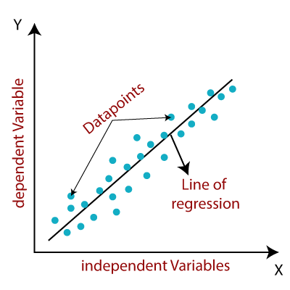
Linear Regression (LR)
Linear regression algorithm shows a linear relationship between a dependent (y) and one or more independent (y) variables, hence called as linear regression. Since linear regression shows the linear relationship, which means it finds how the value of the dependent variable is changing according to the value of the independent variable.

Slide 13

Mean Absolute Error (MAE)
The MAE is the simplest straightforward metric for calculating regression error. The absolute value of the distances between the predicted value and the regression line are used to accomplish this. The MAE is calculated using the following equation,
Here, the number of observations is N, the predicted value is y, and the actual value is x.

Slide 14
Result Analysis
Model | Algo Score | Algo Metric
KNN | 0.866666666666666 | (Accuracy Score ) 0.866666666666666
Logistic Regression | 0.933333333333333 | (Accuracy Score ) 0.933333333333333
Linear Regression | 0.5946120801200767 | (Mean Absolute Error ) 0.28088263202387725

Slide 15
Conclusion
In this research paper, our goal was to find how different machine learning algorithms perform to achieve more accuracy with faster and efficient prediction results. In this study two widely used machine learning algorithms were compared on test sets to predict the possibility of a person to be diabetic. In closing the Logistic Regression model performed better than the Linear Regression (LR) model to achieve finer prediction.

Slide 16


